Slide 2
State of ASP.NET Core
Daniel Roth | @danroth27
Principal Product Manager
Microsoft
Notes:
Hi everyone! I'm Daniel Roth, a Principal Product Manager on the ASP.NET team. I'm excited to share with you today what’s new in ASP.NET Core in .NET 7.

Slide 3
ASP.NET Core: Unified web framework
Extensions
Web UI
Services
Extensions
Web UI
Services
MVC
Razor Pages
SPA
Blazor
HTTP APIs
SignalR
gRPC
Logging
Configuration
Middleware
Middleware
Routing
Security
Localization
Caching
Options
Compression
Session
Health Checks
…
File Providers
Servers
Worker
Services
Servers
Worker
Services
Kestrel
IIS
HTTP.sys
Dependency Injection
Hosting
Hosting
Notes:
ASP.NET Core is our modern Web framework for .NET. It includes everything you need to build beautiful Web UIs and powerful back-end APIs & services. Unlike other development platforms that require you to piece together a Web app from multiple frameworks, ASP.NET Core provides a complete and cohesive Web development solution.
For web UI, you can use MVC and Razor pages to build dynamic server-rendered UI, you can integrate with popular JavaScript frameworks, and you can build rich interactive Web UI completely in C# using Blazor.
For services, you can build standards-based HTTP APIs, real-time services with SignalR, or high-performance back-end services with gRPC.
ASP.NET Core includes a rich array of built-in middleware for handling all of your cross-cutting concerns like routing, security, localization, caching, compression, and much more.
ASP.NET Core also integrates with cloud-ready .NET platform extensions for handling concerns like logging, configuration, dependency injection, and others.
You can then host your ASP.NET Core app using a variety of different HTTP servers, including Kestrel, our built-in ultra fast and cross-platform web server.
No matter what sort of web app you're trying to build, ASP.NET Core has everything you need so you can focus on your app and stay productive.

Slide 4
Industry leading performance
gRPC
2.20M
7.02M
0.61M
Java Servlet
.NET
Node.js
>11X faster than Node.js
Sources: https://www.techempower.com/benchmarks/#section=data-r21&hw=ph&test=plaintext; https://github.com/LesnyRumcajs/grpc_bench/wiki
Notes:
ASP.NET Core delivers industry leading performance.
In the public TechEmpower benchmarks, ASP.NET Core max's out the hardware to handles a whopping 7M requests per sec, 11x faster than Node.js.
gRPC services built with ASP.NET Core handle higher throughput than Java, Go, C++, and Rust.

Slide 5






.NET at Microsoft - Upgrading to .NET 6
Microsoft Graph
Azure Active Directory
Microsoft Teams
70B requests / day
37% CPU
91% Operational costs
185B requests / day
67% CPU
50% app efficiency
50 projects, 700+ APIs
25% CPU
60% P99 latency
Azure Cosmos DB
Exchange Online
Azure App Service
30-65% CPU
5x throughput
85% P95 latency
26% CPU
80% P99 latency
20% Heap size
⇧ 80% throughput
Large  in CPU
Enable gRPC & HTTP/2
Microsoft Graph's Journey to .NET 6
The Azure Cosmos DB Journey to .NET 6
Azure Active Directory's gateway is on .NET 6.0!
Exchange Online Journey to .NET Core
Microsoft Teams' journey to .NET Core
Microsoft Teams Assignments Service's Journey to .NET 6
A Heavy Lift: Bringing Kestrel + YARP to Azure App Services
Notes:
And it doesn't just perform well on benchmarks. ASP.NET Core delivers real world performance to some of the largest services in the world.
At Microsoft we use .NET heavily for many of our products and services. As these services have upgraded to use ASP.NET Core and the latest .NET versions, they've realized enormous performance gains and dramatic improvements in efficiency.
- **Microsoft Graph** provides unified access to data and intelligence in the Microsoft 365 ecosystem. They handle over 70B req/day. By upgrading to .NET 6 from .NET Fx they saw a 37% overall decrease in CPU usage and reduced operational costs by 91% for each 1B requests served.
- **Azure Active Directory**'s gateway service handles over 185B req/day. By upgrading to .NET 6 they reduced overall CPU usage by 67% and increased app efficiency (the ratio of throughput to CPU usage) by 50%.
- **Microsoft Teams** moved over 50 projects with over 700 APIs to .NET 6 reducing CPU usage by 25% and P99 latency by 60%. We've helped upgrade much bigger projects too.
And the list goes on:
- **Azure Cosmos DB** increased throughput by 500% by updating to .NET 6.
- **Exchange Online** decreased P99 latency by 80%
- **Azure App Service** increased throughput by 80% for their front end role, which handles over 160B req/day. They were able to replace nginx on their Linux VMs with ASP.NET Core, which unblocks support for gRPC and HTTP/2.
By building with .NET and ASP.NET Core you can rest assured knowing that you’re on a foundation that is efficient and ready to scale.

Slide 6


Announcing ASP.NET Core in .NET 7
Fast
Faster HTTP/2
Optimized for more cores
Modern
HTTP/3 & WebTransport (experimental)
WebSockets over HTTP/2
ARM64 support for IIS
Simple
Minimal API improvements
Simplified API authentication
Productive
New middleware: output caching, rate limiting, request decompression
SignalR client results
Blazor custom elements
get.dot.net/7
Notes:
Today we announced the release of .NET 7, the latest version of the .NET platform, that's loaded with ASP.NET Core improvements for web developers.
ASP.NET Core in .NET 7 is built for **speed**. If you thought .NET 6 was fast, .NET 7 is even faster!
In .NET 7 we adding support for the latest **modern** protocols, architectures, and standards so you can be sure you're getting the best of the web.
At the same time, we **simplified** web development in .NET 7 so you can get started fast while still taking advantage of all available features.
To help you stay **productive** we added even more middleware, like output caching, rate limiting, and request decompression, to handle common concerns so you don't have to. New features like SignalR client results and Blazor custom elements enable new scenarios and empower you as a developer.

Slide 7
Next level performance with .NET 7
TechEmpower (JSON)
HTTP/2
+16%
>8x
8% Plaintext
16% JSON
25% Fortunes
Sources: Internal benchmarks for .NET 6 vs .NET 7; https://github.com/LesnyRumcajs/grpc_bench/wiki
Notes:
As fast as ASP.NET Core was with .NET 6, in .NET 7 it's even faster, providing next level performance.
Thanks to performance optimizations across the .NET platform, ASP.NET Core in .NET 7 is significantly faster on all the major TechEmpower benchmarks: 8% faster on Plaintext, 16% faster JSON handling, and 25% faster on the e2e Fortunes test.
ASP.NET Core support for HTTP/2 is now highly optimized in .NET 7. gRPC server streaming over HTTP/2 with ASP.NET Core is now 8x faster in .NET 7, making it faster than Go.

Slide 8

More cores, more speed
5x RPS
Running on 80 core Ampere Altra VMs on Azure
TechEmpower plaintext benchmark
Notes:
In .NET 7 we also optimized ASP.NET Core to take advantage of the processing power of machines with many cores. ASP.NET Core is now five times faster than .NET 6 when running on the massive 80 core ARM64 Ampere Altra VMs on Azure.
All of these performance improvements mean lower operational costs and better experiences for your users.

Slide 9
The latest protocols
HTTP/3
Faster connections and better multiplexing with QUIC
WebSockets over HTTP/2
Familiar full duplex communication now over HTTP/2
WebTransport (experimental)
Multiplex unidirectional streams, bidirectional streams, and data grams over the same HTTP/3 connection
Notes:
We work hard to support the latest protocols and standards with quality implementations tuned for performance and hardened for security.
In .NET 7, ASP.NET Core now supports:
- **HTTP/3**, the latest HTTP version, which enables faster connections and better connection multiplexing with the new UDP-based QUIC transport protocol
- **WebSockets over HTTP/2**, for full duplex communication using a familiar programming model
- Experimental support for **WebTransport**, a new draft protocol for multiplexing unidirectional and bidirectional streams and data grams over HTTP/3 connections
Each of these protocols is supported cross-platform and cross-architecture using Kestrel, our built-in web server.

Slide 10
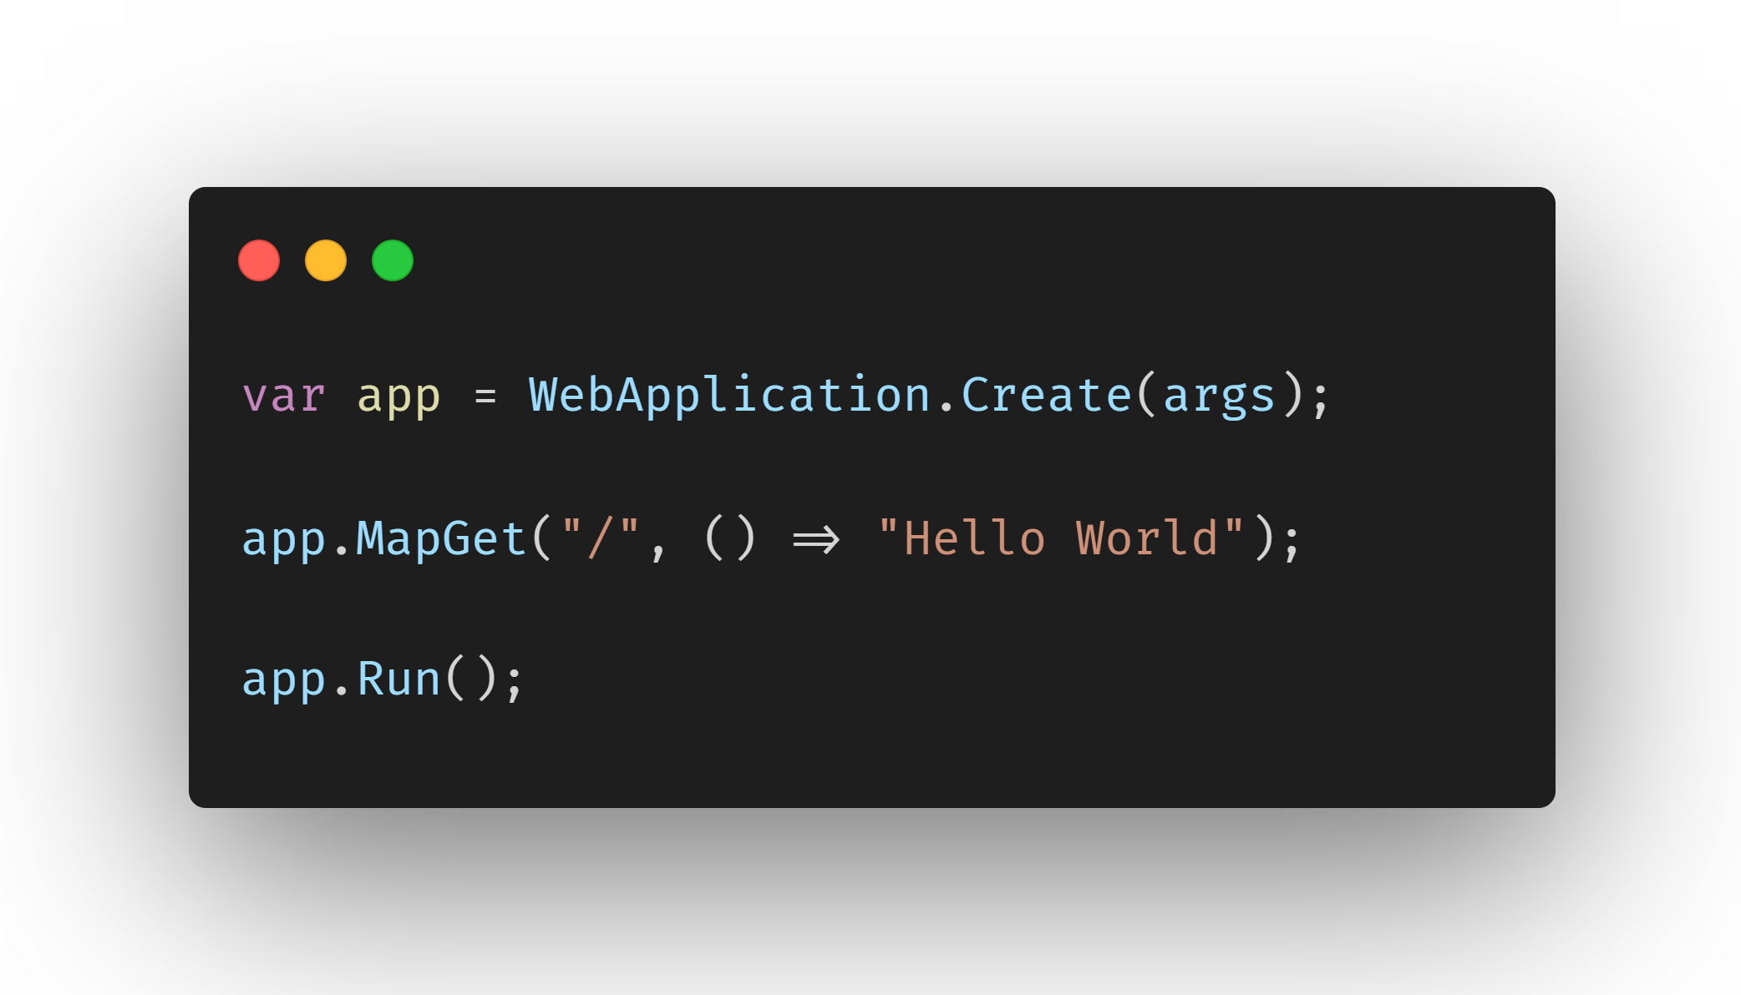
Get started with minimal APIs
Lightweight, single-file, cloud native APIs
Low ceremony, top-level C# programs
Easy to get started
Scale to any app size
Notes:
With ASP.NET Core you can build apps big and small.
In .NET 6 we started work to simplify getting started with ASP.NET Core and to push popular MVC features lower in the stack. This effort led to a simplified hosting model and minimal APIs.
Minimal APIs simplify web API development, make various MVC features more broadly available, and offer enhanced performance.

Slide 11
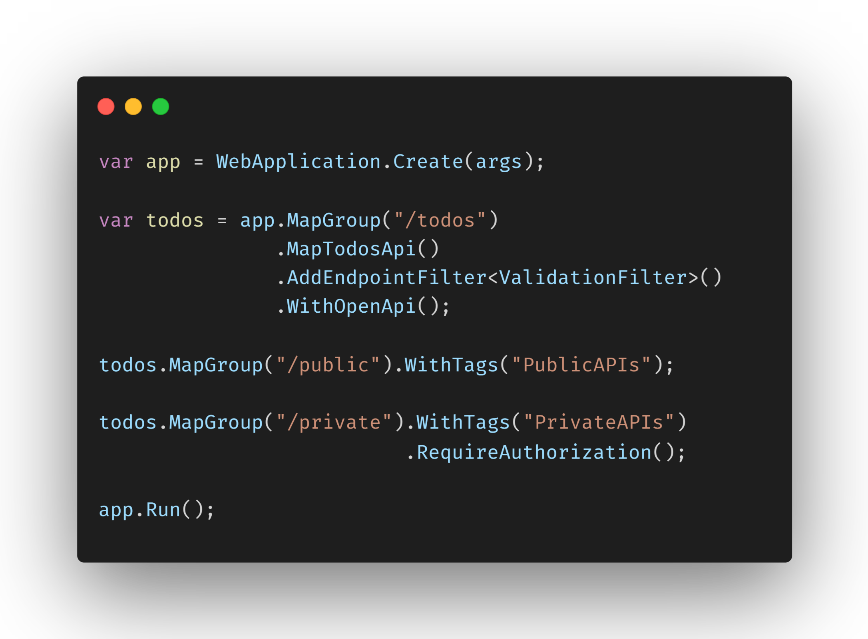
Simple and powerful
Organize groups of endpoints
Leverage endpoint filters for validation, logging, and much more
Improved testing and OpenAPI docs
Simplified API authentication
Notes:
In .NET 7 we've improved minimal APIs further to ensure your APIs can be both simple and powerful.
- We added support for endpoint groups, so that you can organize your minimal APIs under a common URL prefix and configure them together
- You can now add endpoint filters to your APIs and groups to add cross cutting functionality like validation and logging.
- We made minimal APIs more explicit so they're easier to test and have improved OpenAPI generation support
- We also simplified how you configure authentication for your APIs, making it easier to build and test secure endpoints.

Slide 12
Demo
Powerful APIs, minimal code
Notes:
Let's take a look at how easy it is to get started with ASP.NET Core in .NET 7 using minimal APIs.

Slide 13





Beautiful Web UI with Blazor
WebAssembly
Build interactive web UI all in C#
Share UI across web and native
Run on the server, WebAssembly, or in a hybrid native app
Integrate into JavaScript apps using Blazor custom elements
Server
Hybrid
Notes:
.NET 7 also includes many improvements for building web UI with ASP.NET Core & Blazor. With Blazor you can build your web UI completely in C# using reusable components.
These components can then be shared across web, mobile, and desktop. You can run your components from the server, on WebAssembly in a browser, or in a hybrid native client app.
If you already have significant JavaScript investments, you can integrate Blazor components into your existing JavaScript apps too using the new Blazor custom elements support in .NET 7.

Slide 14
Demo
Blazor everywhere
Notes:
Let me show you how flexible Blazor component are in .NET 7.
The .NET Podcasts web app is completely implemented using ASP.NET Core & Blazor. The podcast player is built using Blazor components that run client-side in the browser on WebAssembly. The Blazor components call the minimal APIs you saw previously. Because the app runs client-side, users gets a rich interactive experience.
The same Blazor components used in the web app can also be hosted in a native client app. Here we're using .NET MAUI to host our Blazor components and render them to an embedded web view, a BlazorWebView. By hosting our Blazor components using this hybrid approach of native and web we can light up native client feature, like native audio playback. By using Blazor we're able to share our UI across mobile, desktop, and web.

Slide 15
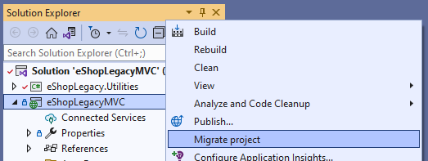


Incrementally upgrade to ASP.NET Core
Use Visual Studio to set up an ASP.NET Core migration project
YARP proxies requests from the new ASP.NET Core app to the existing ASP.NET app as needed
Migrate endpoints to ASP.NET Core one at time including any dependencies
Continue maintaining & developing your ASP.NET app while upgrading
Learn more
|
aka.ms/aspnet/upgrade
Notes:
We want every ASP.NET dev to be able to take advantage of ASP.NET Core, so we've been doing work to help upgrade ASP.NET apps using an incremental approach.
Upgrading ASP.NET apps to ASP.NET Core can be challenging because of the number of changes required. If you're ASP.NET app is still in active development, trying to migrate to ASP.NET Core can sometimes feel like a race with a moving finish line.
The new incremental migration tooling in Visual Studio helps you set up an ASP.NET Core app in front of your existing ASP.NET app using YARP, our reverse proxy. Any requests not handled by the new ASP.NET Core app continue to be handled by your existing ASP.NET app. You can then move endpoints and pages over to the new app one at a time including any dependencies. As you incrementally upgrade, you can continue to develop and maintain the old app.

Slide 16

More ASP.NET Core in .NET 7 – stay tuned!
Runtime
HTTP/3
WebSockets over HTTP/2
ARM64 for IIS
Optimized for many cores
Rate limiting
Output caching
Request decompression
WebTransport (experimental)
APIs
Route grouping
Endpoint filters
Enhanced OpenAPI support
Simplified JWT authentication
SignalR client results
Dependency injection for Hub methods
gRPC JSON transcoding
Web UI
Blazor custom elements
Handle location changing events
Data binding get/set/after modifiers
Improved JavaScript interop
WebAssembly SIMD & exception handling
Dynamic authentication requests
QuickGrid (experimental)
Notes:
ASP.NET Core in .NET 7 includes so many improvements across all areas of the framework. I listed as many here as I could reasonably fit. Obviously, we couldn’t cover all of these in this session, but fortunately there are many great sessions right after this one cover Blazor, minimal API, and runtime improvements that you should definitely check out. So stay tuned to .NET Conf for some really great stuff for web developers!

Slide 17


Thank You!
Let's build amazing apps with .NET 7 get.dot.net/7
Notes:
I hope you enjoyed learning about the many improvements to ASP.NET Core in .NET 7. We look forward to see what you build with this release. Thank you for listening, happy coding, and with that let’s see if there are any questions.

